Slide 1
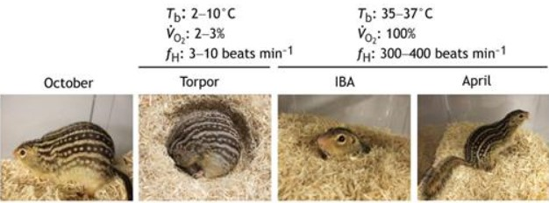
Hibernation and Metabolic in Ground Squirrels Through Mass Spectrometry Analysis and R Data Visualization
Image adapted from Andrews M. T. (2019).

Slide 2
Objectives
The focus is on data analysis and visualization of Mass Spectrometry (MS) data metabolomics analysis.
Identified key metabolites and metabolic pathways activated during hibernation.

Slide 3
Packages Used for plots
(openxlsx)
(ggplot2)
(ggpubr)
(ggthemes)
(Ellipse)
(ggplot)
(gmodels)
(Export)
(tidyverse)

Slide 4
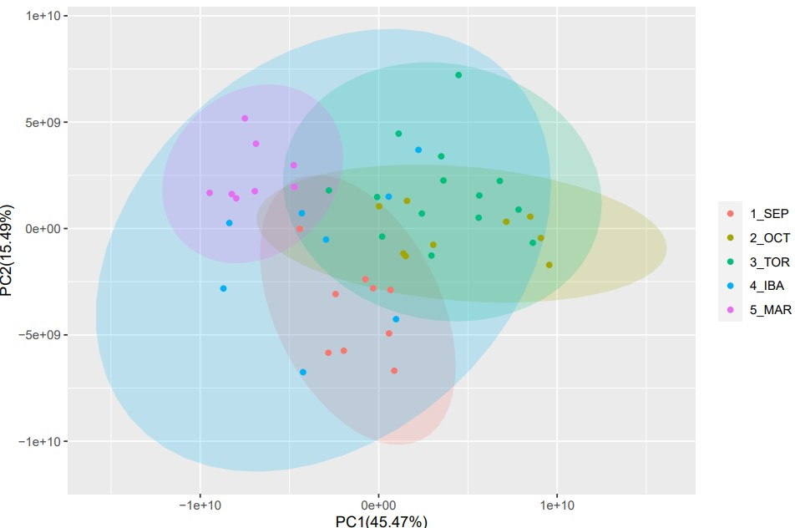
PCA Plot of metabolites

Slide 5
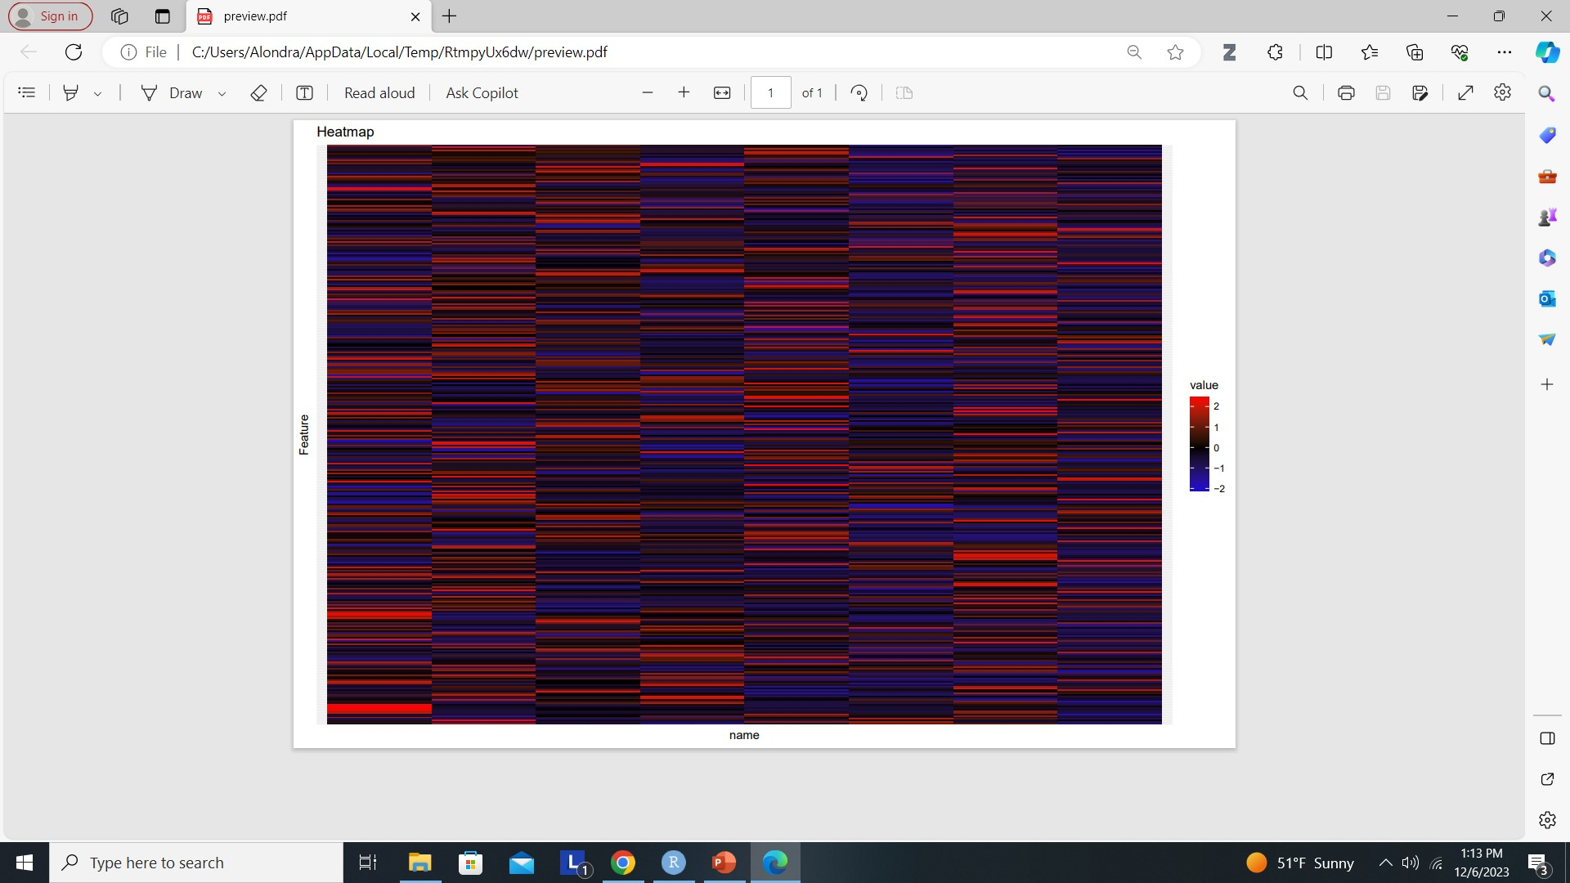
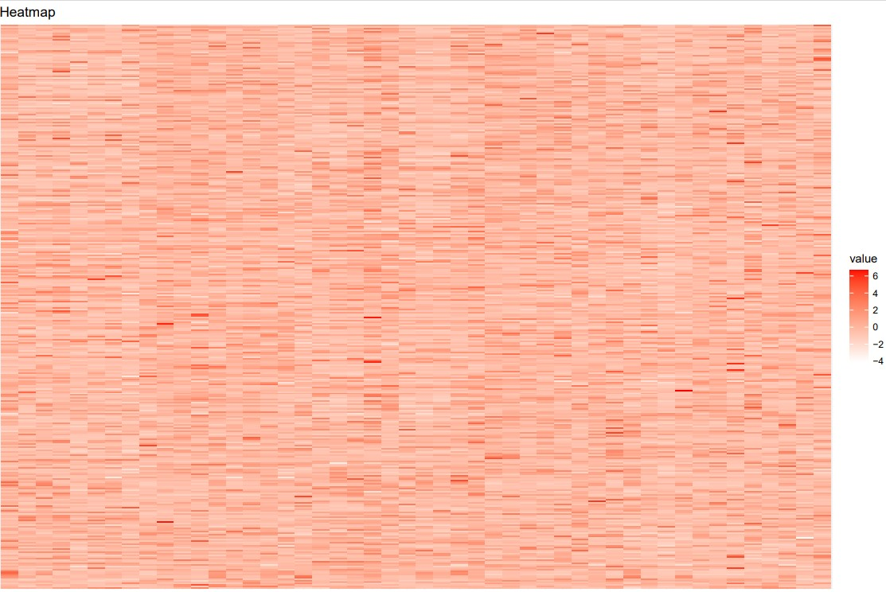
Heatmaps of the different variables
FULL DATA SET
IBA
Metabolites
Metabolites
variable
variable

Slide 6
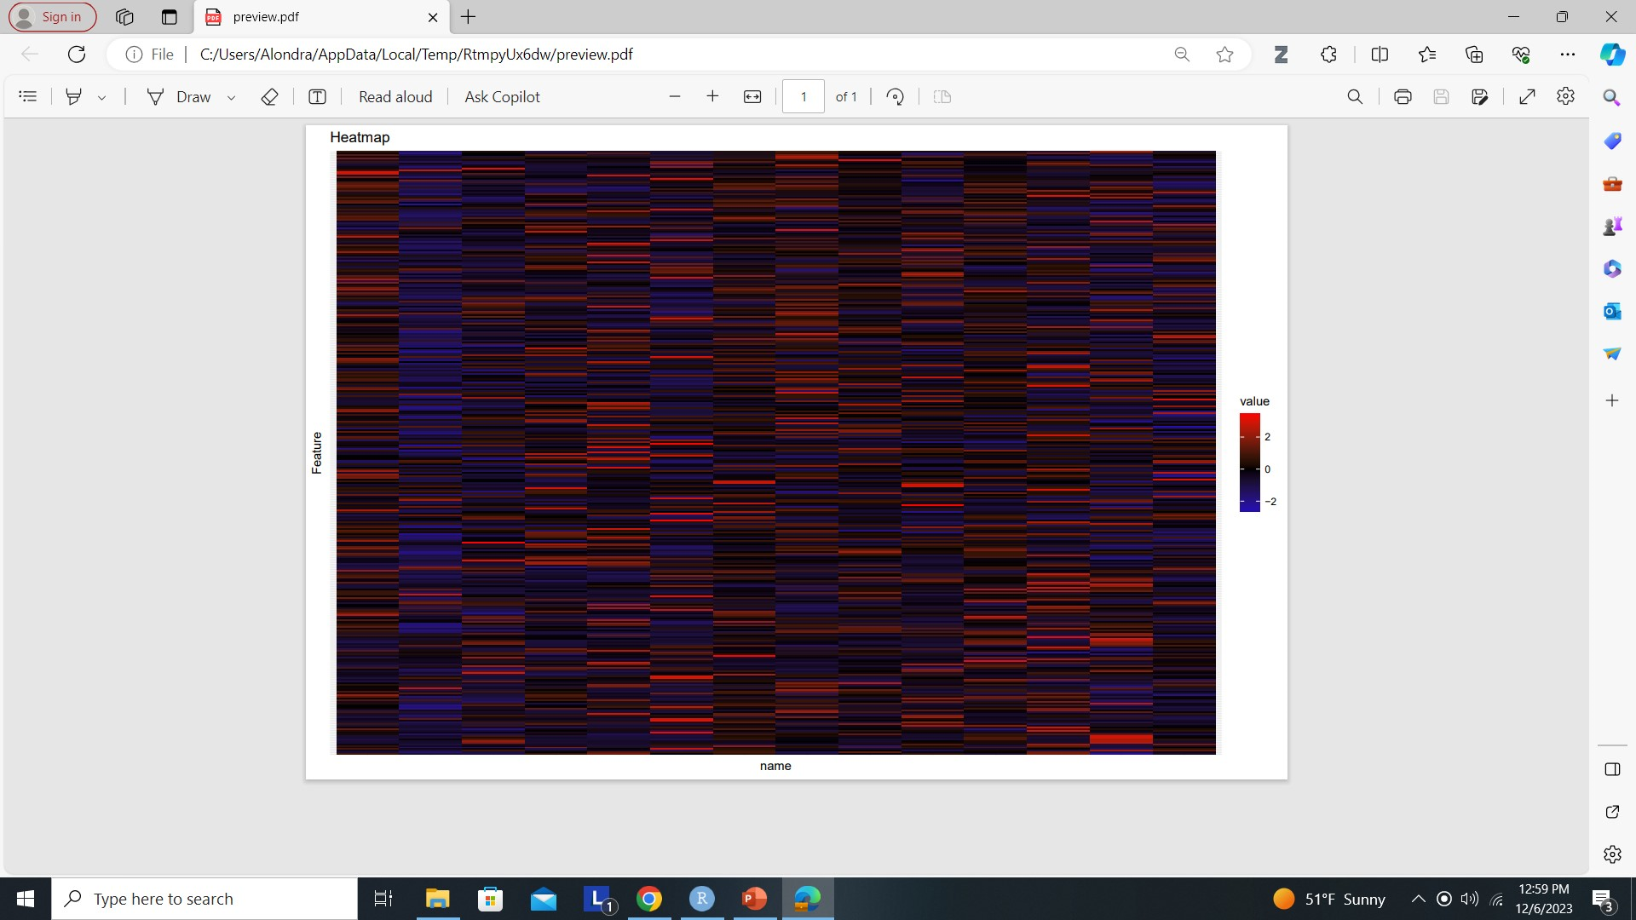
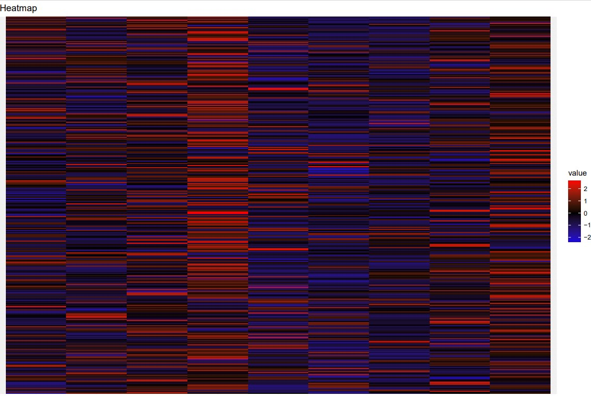
Heatmaps of the different variables
TOR
SEP
Metabolites
Metabolites
variable
variable

Slide 7
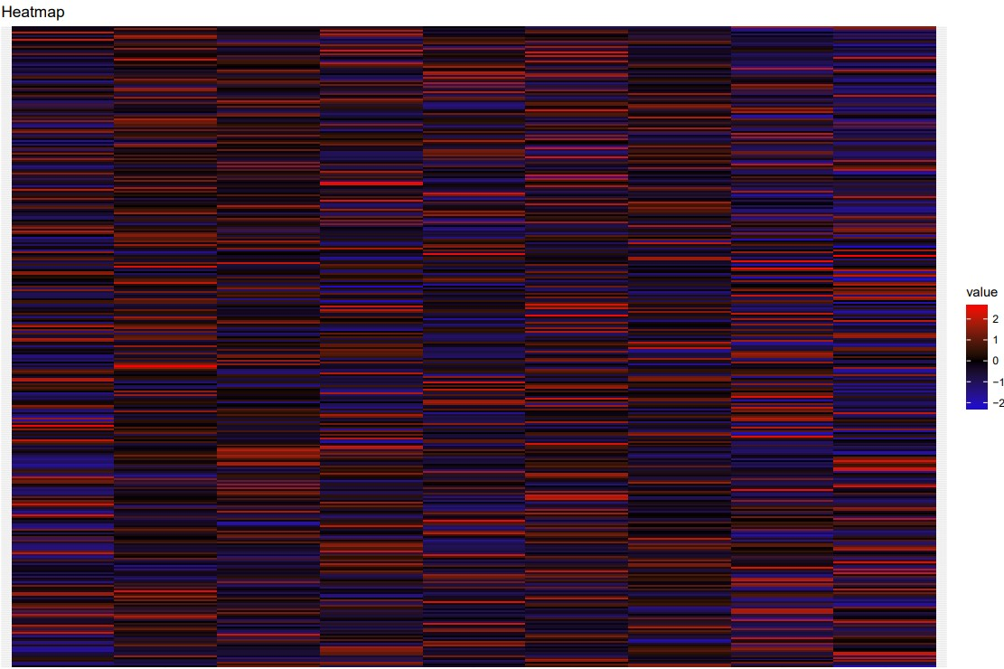
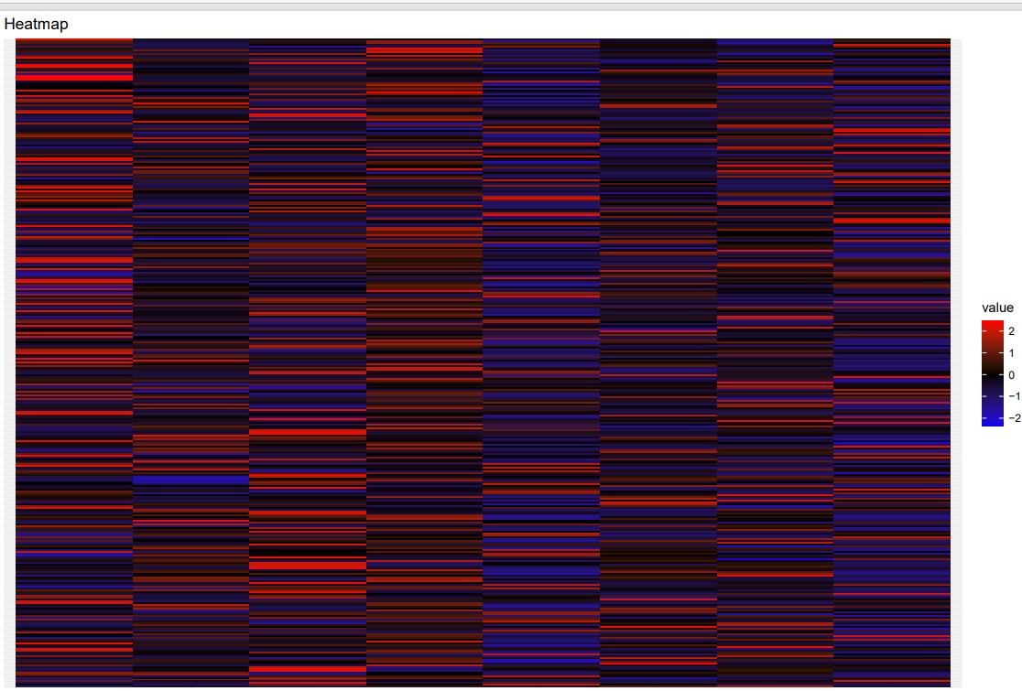
Heatmaps of the different variables
OCT
MAR
Metabolites
Metabolites
variable
variable

Slide 8
Determine top metabolites for the entire dataset
193- Erythrose, 4-phosphate
11- (4S)-4-{[(9Z)-3-Hydroxy-9-hexadecenoyl]oxy}-4-(trimethylammonio)butanoate_0
70-3-hydroxydodecanoylcarnitine
255- L-Histidine
39- 2,2'-[1,2-Propanediylbis(oxy)]diethanol
(top_metabolites_IBA)
328-Ricinine
11- (4S)-4-{[(9Z)-3-Hydroxy-9-hexadecenoyl]oxy}-4-(trimethylammonio)butanoate_0
12-(4S)-4-{[(9Z)-3-Hydroxy-9-hexadecenoyl]oxy}-4-(trimethylammonio)butanoate_1
70-3-hydroxydodecanoylcarnitine
10-(4S)-4-[(2E,4Z)-2,4-Decadienoyloxy]-4-(trimethylammonio)butanoate_1
(top_metabolites_MAR)
340-Threonylglutamine
332-ser-arg
198-gln-ala
222-Hypusine
128-Argininosuccinic acid
(top_metabolites_OCT)
132-Asparagine
347-Urea
91-4-Guanidinobutyric acid
85-4-[(3-Acetamidopropyl)amino]butanoic acid
20- {3-[(3-{[4-(Hydroxymethyl)cyclohexyl]amino}-3-oxetanyl)methyl]-1,2-oxazol-5-yl}methanol
(top_metabolites_all)
"193" "11" "70" "255" "39"
(top_metabolites_IBA)
"328" "11" "12" "70" "10"
(top_metabolites_MAR)
"340" "332" "198" "222" "128"
(top_metabolites_OCT)
"132" "347" "91" "85" "20"
(top_metabolites_SEP)
"82" "244" "315" "342" "266"
(top_metabolites_TOR)
"342" "341" "288" "82" "243"

Slide 9
Determine top metabolites for the entire dataset
(top_metabolites_SEP)
82-4-(1,2-Dihydroxy-2-propanyl)-1-methyl-1,2-cyclohexanediol
244-Leucylasparagine
315-Phenylalanylarginine
342-trans-3-Indoleacrylic acid
266-Melezitose
(top_metabolites_TOR)
342-trans-3-Indoleacrylic acid
341-Threonylleucine
288-N6-Me-Adenosine
82-4-(1,2-Dihydroxy-2-propanyl)-1-methyl-1,2-cyclohexanediol
243-Leucine

